Slide 1

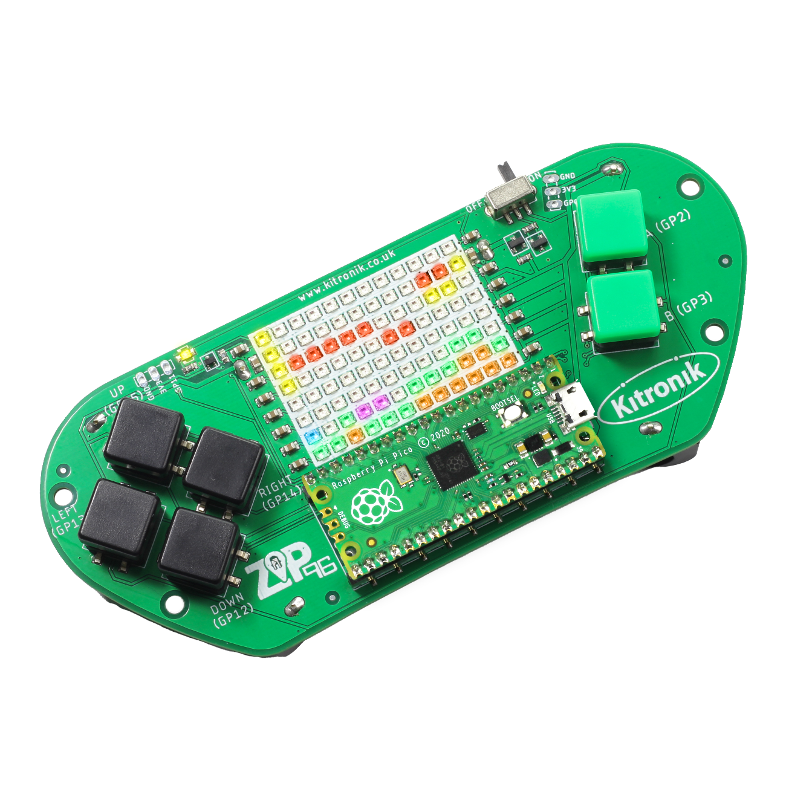
creating the a-mazing game
Computer Science

Slide 2

Aims & objectives
Computer Science
By the end of this lesson you will have:
Learnt about dual core processors.
Separated the main game code and user input into different threads.
Added a check for win conditions to the main game loop.

Slide 3
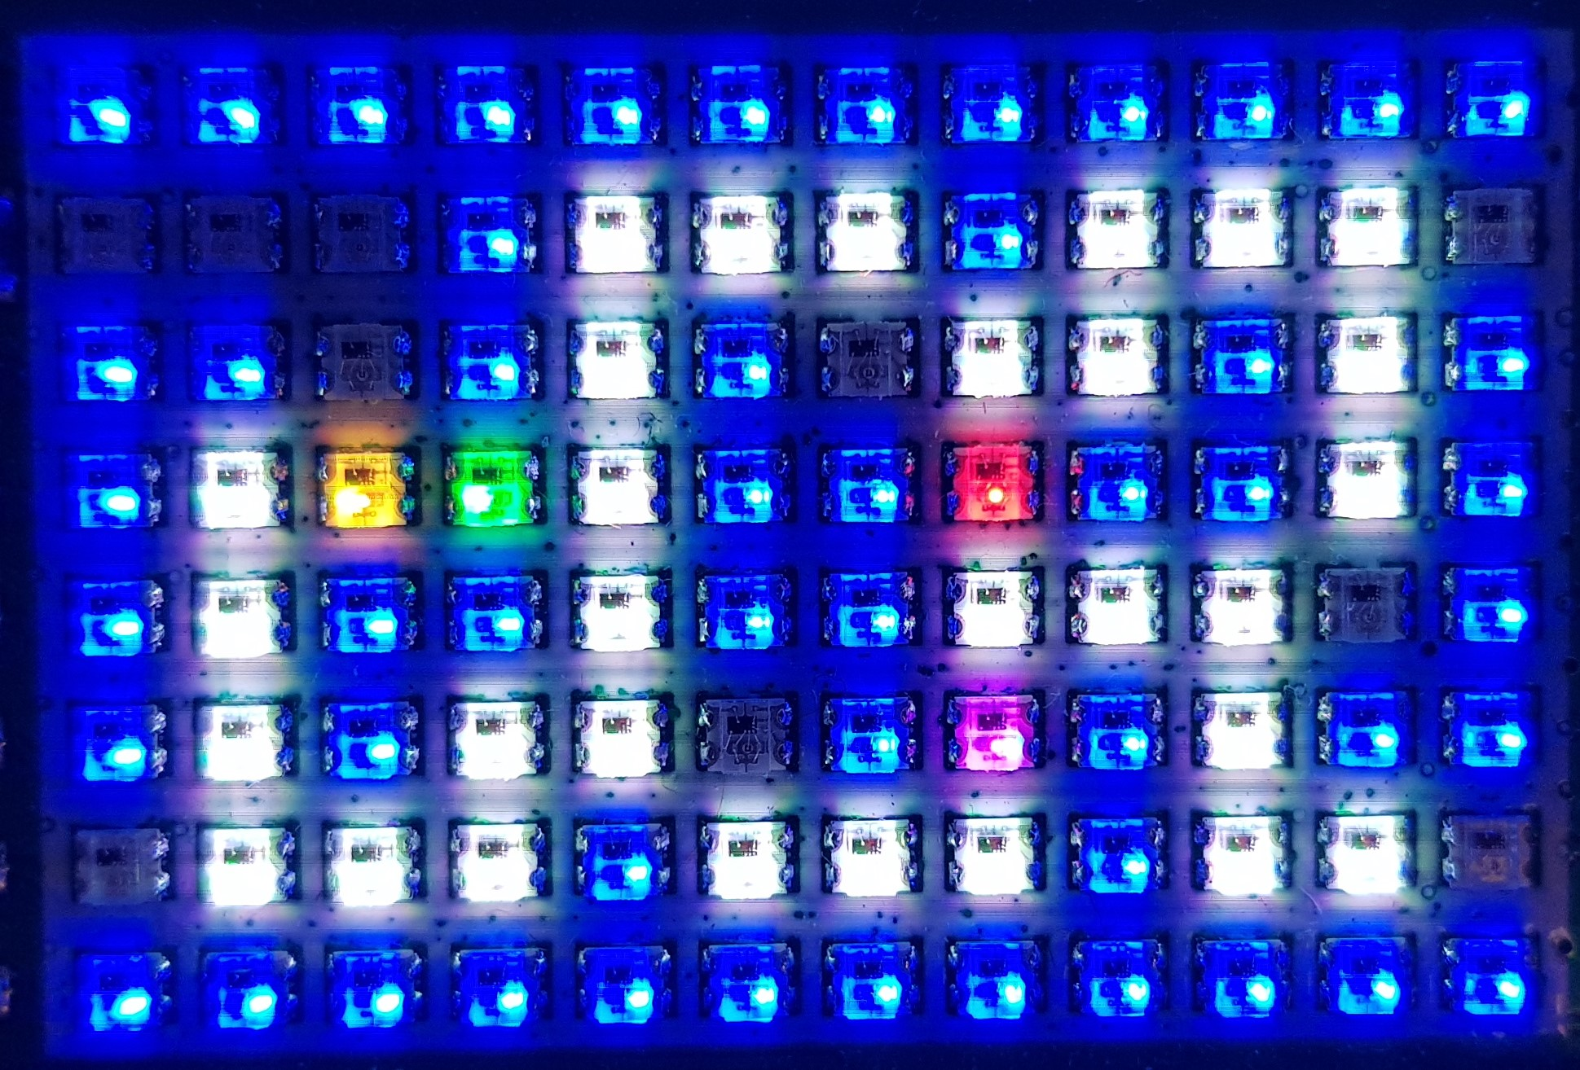
What is our a-mazing game?
Computer Science
A maze-based game where the player runs through a maze collecting gems – collect all the gems to win.
Three different enemies move around the maze as well, trying to stop the player from collecting gems.
One enemy moves randomly, one simply tries to move towards the player, the final one is smart and finds the best path through the maze to the player.
If an enemy catches the player, they lose a life. Once all three lives are lost… game over!

Slide 4
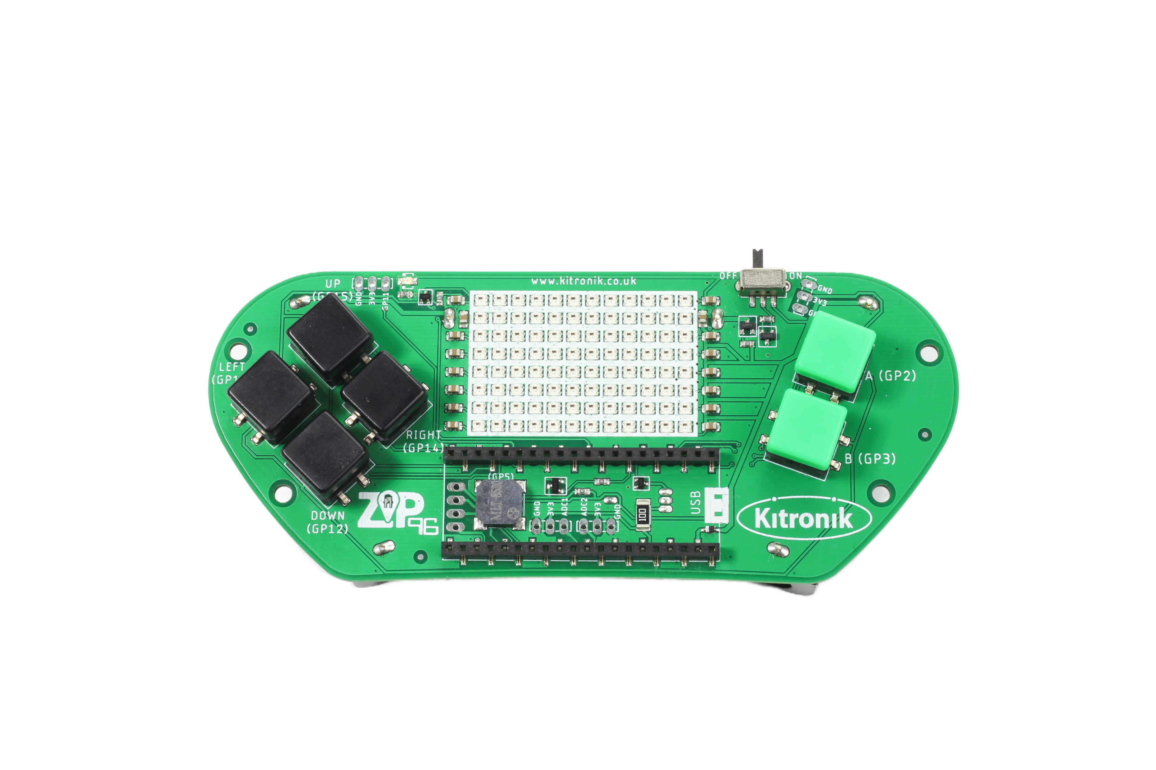
Thonny setup
Computer Science
Connect Pico ZIP96 to computer using a USB cable and open Thonny.

Slide 5
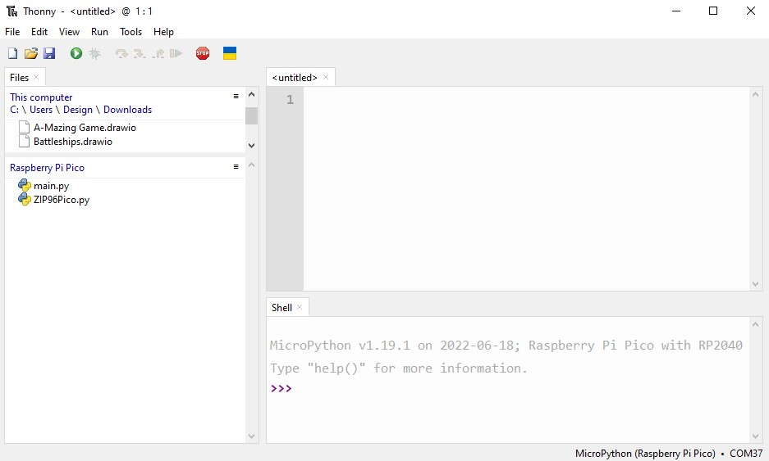
Thonny setup
Computer Science
Check the Pico device appears in the bottom right corner of Thonny.
Try pressing STOP if it does not appear automatically.
Turn on the ‘Shell’ by going to ‘View > Shell’.

Slide 6
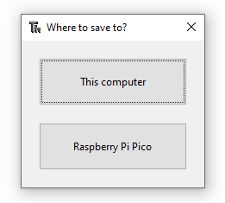
Thonny setup
Computer Science
Create a new file by clicking ‘File > New’.
Save it to the Pico by clicking ‘File > Save as’ and then select ‘Raspberry Pi Pico’.
Name the file ‘main.py’.

Slide 7
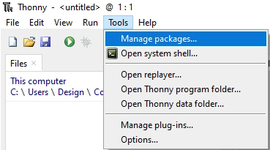
Thonny setup
Computer Science
Install the ‘ZIP96Pico’ library onto the Pico.
Click on ‘Tools > Manage Packages…’

Slide 8
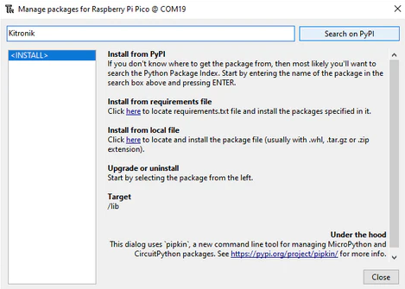
Thonny Setup
Computer Science
With the ‘Manage packages’ window open, search for ‘Kitronik’ and click the ‘Search on PyPI’ button.
Locate ‘KitronikPicoZIP96’ in the list of search results, then click the ‘Install’ button.
Confirm the install by clicking ‘Yes’ if prompted by Thonny.

Slide 9
Coding: libraries & variables
Computer Science
Import the ‘_thread’ library after the ‘sleep’ import:
In the game variables, add ‘lives’ after ‘moveY’:
from utime import sleep
import _thread
moveY = 0
lives = 3

Slide 10
Coding: define the second thread
Computer Science
Above the game loop, start defining a new function:
# Get input from the ZIP96Pico Gamer in a separate thread
def gamerInput(gamer, lives):
global moveX, moveY
buzzer = gamer.Buzzer
haptic = gamer.Vibrate

Slide 11


Coding: define the second thread
Computer Science
Inside the gamerInput() function, a loop needs to be used to run the input code.
What type of loop should be used, and what condition should be checked to keep it running?
Hint: It should make use of the new ‘lives’ variable.

Slide 12
Coding: second thread loop
Computer Science
Add to the new gamerInput() function:
# Start game loop
while lives > 0:
# When up pressed,
# change player y position by -1
if (gamer.Up.pressed()):
buzzer.playTone(1000)
haptic.vibrate()
moveX = 0
moveY = -1
sleep(0.1)
# When down pressed,
# change player y position by 1
if (gamer.Down.pressed()):
buzzer.playTone(1000)
haptic.vibrate()
moveX = 0
moveY = 1
sleep(0.1)

Slide 13
Coding: second thread loop continued
Computer Science
Continue adding to the gamerInput() function:
# When left pressed,
# change player x position by -1
if (gamer.Left.pressed()):
buzzer.playTone(1000)
haptic.vibrate()
moveX = -1
moveY = 0
sleep(0.1)
# When right pressed,
# change player x position by 1
if (gamer.Right.pressed()):
buzzer.playTone(1000)
haptic.vibrate()
moveX = 1
moveY = 0
sleep(0.1)
buzzer.stopTone()
haptic.stop()

Slide 14
Coding: Start the new thread
Computer Science
After the gamerInput() function, start the new thread running:
# Start ZIP96Pico Gamer input logic in a separate thread
_thread.start_new_thread(gamerInput, (gamer, lives))
Run the program to test the new thread is working correctly

Slide 15
Coding: Update main game loop
Computer Science
After the gamerInput() function, start the new thread running:
# Start game loop
while lives > 0:
# Wait for moveDelay before moving
sleep(moveDelay)
# Update the player position using the move values
player.move(moveX, moveY)
# Check if the player has found all the gems
if player.foundGems == len(gems):
# Set the screen to green
screen.fill(screen.GREEN)
screen.show()
# Set lives to zero to end the game loops
lives = 0
break
# Show the updates on the screen
screen.show()
Run the program to test the win condition works correctly when all gems are collected

Slide 16
conclusion
Computer Science
In this lesson you have:
Learnt about CPU cores.
Created a second thread.
Separated user input and game logic using parallelism.
Added win conditions to the game.

